Slide 1

PsychoBot - 1st Sprint
Noam & Dolev

Slide 2
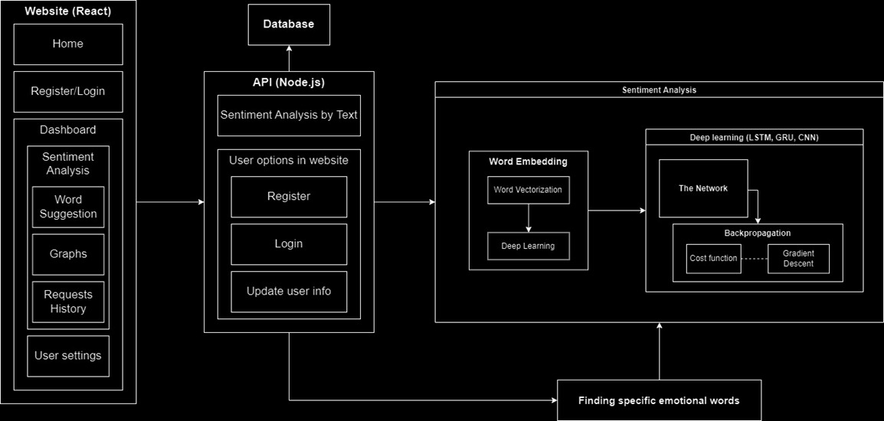
Architecture

Slide 3
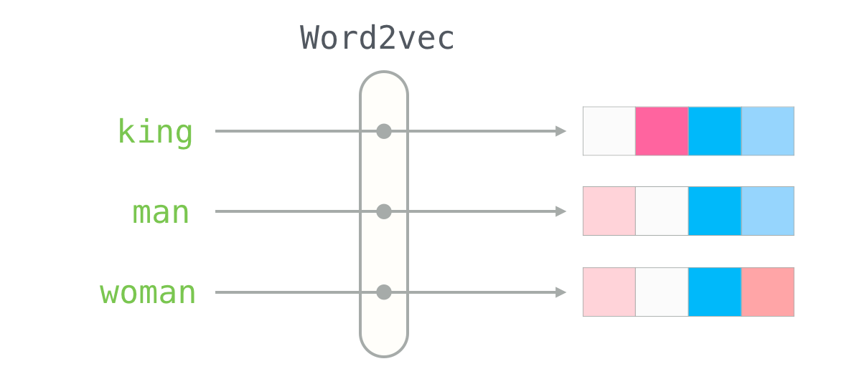
Goals
Neural Network – with LSTM Architecture (Long short-term memory)
Dataset loading and parsing (Word embedding, Sterilization, and Lemmatization)

Slide 4
Roadmap
Studied and understood the Spacy library and its use of word embedding
Downloaded sentences and emotions from Kaggle website
Used AI to learn the dataset
Improved AI with LSTM architecture
Developed understanding of underlying algorithms and math behind LSTM.

Slide 5
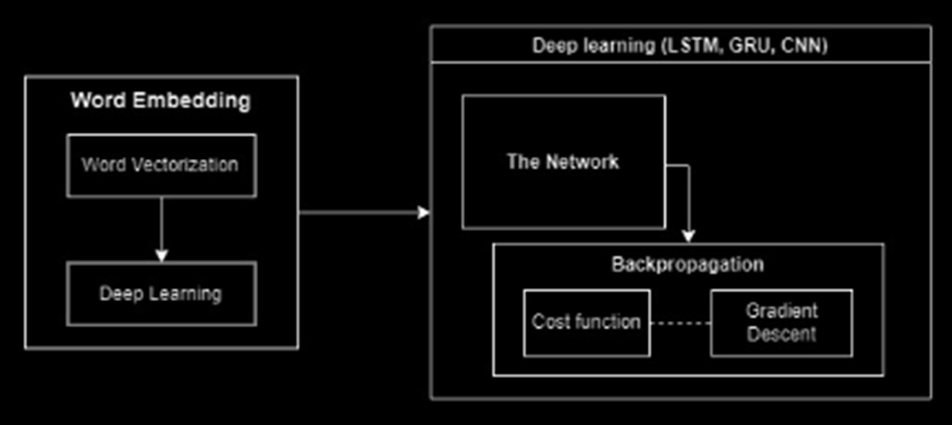

Slide 6
Conservation
Importance of thorough research before writing code
Benefits of working collaboratively
Understanding all aspects of code through collaboration

Slide 7
Improvement
Benefits of working alone to optimize time
Importance of writing code that can be run incrementally
Avoiding waiting until the end of a sprint to test code

Slide 8
Next Sprint
Neural Network with GRU architecture
API and Website
Improvement of the LSTM Architedture

Slide 9
Next Sprint
Neural Network with GRU architecture
API and Website

Slide 10
https://www.youtube.com/watch?v=8rQPJnyGLlY

Slide 11
Questions?

Slide 12
Thank you!

